Slide 1
Lecture 5
Bottom-Up Parsing

Slide 2
Outline
Overview of Bottom-Up Parsing
Overview of LR Parsing Method
Finite Automata of LR(0) Items and LR(0) Parsing
SLR(1) Parsing

Slide 3
Overview of LR Parsing Method
There are different Bottom-Up parsing methods, we will only talk about LR(K) Parsing method
LR(K) Parsing: Basing on the string on top of the parsing stack (represented as state) and using the next K (K≥0) tokens in the input as lookahead to determine handle for reduction
L indicates that the input is processed from left to right
R indicates that a rightmost derivation is produced
K for the number of input symbols of lookahead that are used in making parsing decisions

Slide 4
The consequence of the power of LR(k) parsing
LR(0) parsing, where no lookahead symbol is consulted in making parsing decisions
SLR(1) parsing (simple LR(1)) is an improvement on LR(0)
LR(1) parsing is the most powerful and most complex (with one lookahead symbol)

Slide 5
Schematic Form of LR parser
Input
a1
…
ai
…
an
$
Stack
LR
Parsing Program
Sm
Output
Xm
S_{m-1}
X_{m-1}
…
action
goto
Parsing Table
S₀
$
LR parser

Slide 6
Parsing Table
Each line represents a state, each column is a grammar symbol
 | ACTION |  |  |  |  |  | GOTO
 | a | c | e | b | d | $ | a | c | e | b | d | $ | S | A | B
0 | s |  |  |  |  |  | 2 |  |  |  |  |  | 1
1 |  |  |  |  |  | acc
2 |  | s |  | s |  |  |  | 1 |  | 3
3 | r2 | r2 | r2 | r2 | r2 | r2
ACTION: take a state and a terminal symbol, determine the next action to take place
GOTO: take a state and a grammar symbol, determine the next state

Slide 7
To save space, compress ACTION and GOTO on columns of terminals
 | ACTION |  |  |  |  |  | GOTO
 | a | c | e | b | d | $ | a | c | e | b | d | $ | S | A | B
0 | s |  |  |  |  |  | 2 |  |  |  |  |  | 1
1 |  |  |  |  |  | acc
2 |  | s |  | s |  |  |  | 1 |  | 3
3 | r2 | r2 | r2 | r2 | r2 | r2
 | ACTION |  |  |  |  |  | GOTO
 | a | c | e | b | d | $ | S | A | B
0 | s2 |  |  |  |  |  | 1
1 |  |  |  |  |  | acc
2 |  | s1 |  | s3
3 | r2 | r2 | r2 | r2 | r2 | r2

Slide 8
ACTION Table
The table entry (action[S_{m},a_{i}]) for state S_{m} and input a_{i} has four values:
Shift(s_{k})
Put symbol a_{i} and state K into the stack
Reduction(r_{k})
Reduce by number k production (A->γ), the action includes:
Pop the string γ and all of its corresponding states from the stack. Suppose currently the top of stack is state Si
Push A onto stack
Push the state Sj =GOTO[Si,A] onto stack
Accept
Indicate that parsing is completed successfully
Error (Empty)
Indicate that parsing has discovered an error

Slide 9
Example of LR Parsing (SLR(1))
G[S]：(1)S->aAcBe (2)A->b (3)A->Ab (4)B->d
LR Parsing for string “abbede$”
 | ACTION |  |  |  |  |  | GOTO
 | a | c | e | b | d | $ | S | A | B
0 | s2 |  |  |  |  |  | 1
1 |  |  |  |  |  | acc
2 |  |  |  | s4 |  |  |  | 3
3 |  | s5 |  | s6
4 |  | r2 |  | r2
5 |  |  |  |  | s8 |  |  |  | 7
6 |  | r3 |  | r3
7 |  |  | s9
8 |  |  | r4
9 |  |  |  |  |  | r1
Parsing table is:

Slide 10
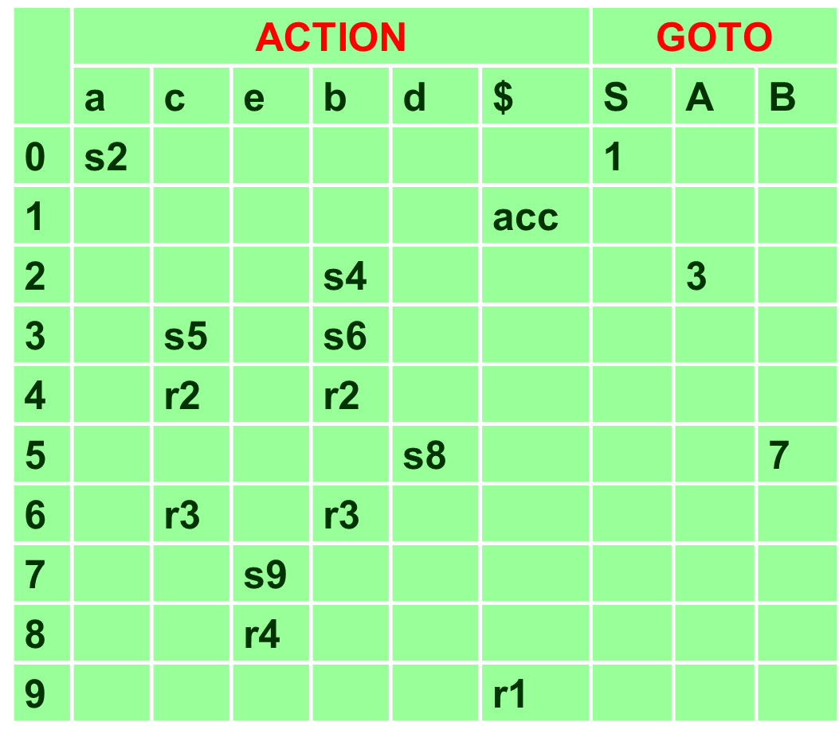
LR parsing process of “abbcde$”
(1)S->aAcBe (2)A->b (3)A->Ab (4)B->d
Stack
Input
Action
Goto
1
$0
abbcde$
s2
2
$0a2
bbcde$
s4
3
$0a2b4
bcde$
r2
3
4
$0a2
bcde$
s6
A
3
5
$0a2A3b6
cde$
r3
3
6
$0a2
cde$
s5
A
3
7
$0a2A3c5
de$
s8
8
$0a2A3c5d8
e$
r4
7
9
$0a2A3c5
e$
s9
B
7
10
$0a2A3c5B7e9
$
r1
1
11
$0
$
acc
S
1

Slide 11
Summarization of LR parsing method
LR Parsing Program is the same for all LR parsers, only parsing table changes from one parser to another
So the key of LR parser is how to construct a parsing table for each different grammar and different LR parser?

